Slide 1
SAP EWM EXTENDED WAREHOUSE MANAGEMENT TRAINING
AnubhavTrainings.com
www.anubhavtrainings.com

Slide 2

SAP EWM TRAINING
BY:-
Mr. Bijoy
www.anubhavtrainings.com
Notes:
https://unsplash.com/photos/uXB-7la5vqA

Slide 3
SAP EWM TRAINING (Day 10)
AnubhavTrainings.com

Slide 4
Outbound Process / Stock Removal Process (Topic)
End to End Outbound process steps
Delivery document types for Outbound, Item types for Outbound
Warehouse Process type & related Configuration, Stock type removal
Stock removal Strategies, Stock removal indicator
EWM Physical Inventory
Define Physical Inventory area

Slide 5
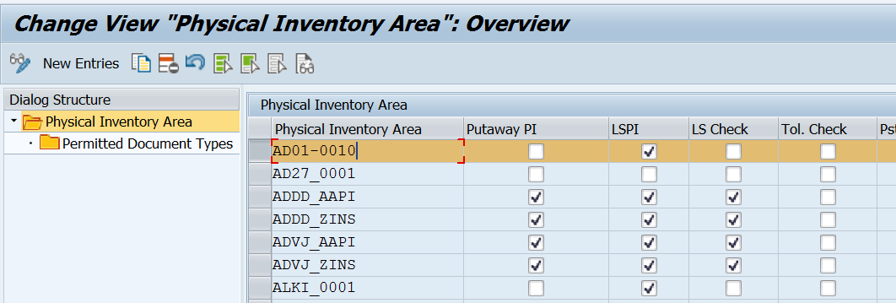
EWM Physical Inventory
Organizational unit in a physical inventory process comprising a number of locations.

Slide 6
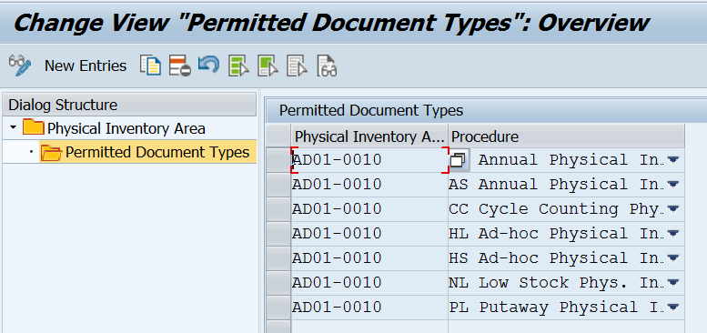

Slide 7
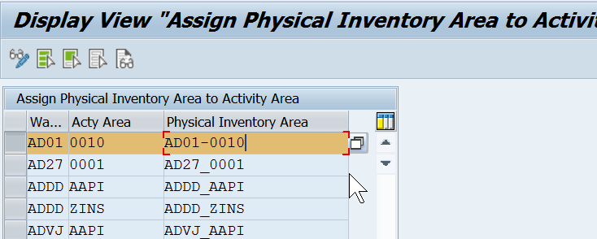
Assign Physical Inventory area to Activity area

Slide 8
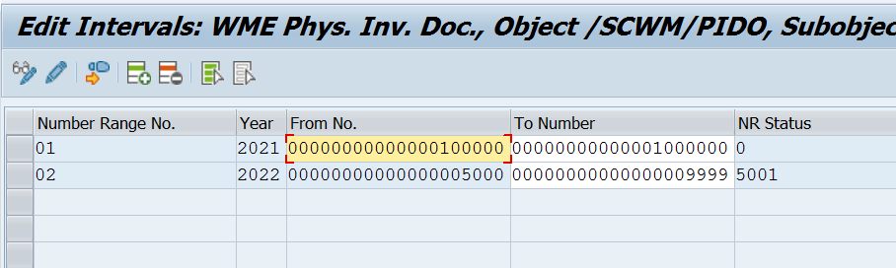
Define Number range for PI Documents

Slide 9
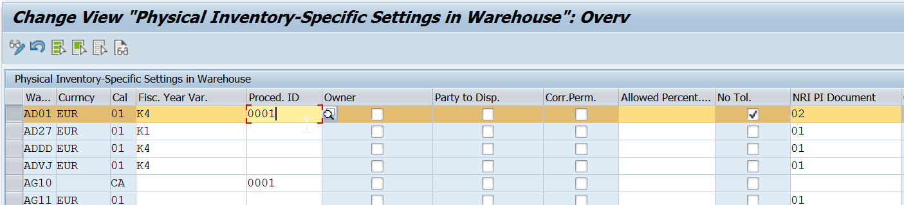
Define PI specific settings in the warehouse

Slide 10
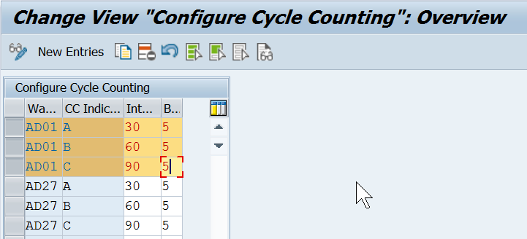
Configure Cycle counting
For each warehouse number, you define the following for the cycle counting physical inventory procedure:
The indicator is maintained according to the master data of the material. Can be found in the menu under Extended Warehouse Management -> Master Data -> Product -> Maintain Warehouse Product)

Slide 11
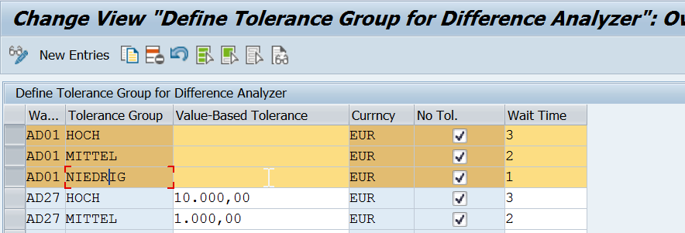
Define Tolerance group for difference analyser

Slide 12
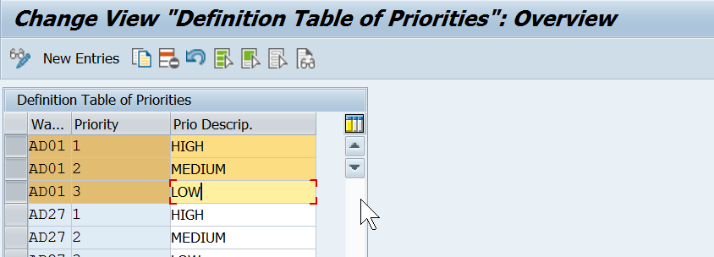
Define Priorities
In this IMG activity, you define the priorities that are permitted for each warehouse number. The priority is used to control the ur
www.anubhavtrainings.com

Slide 13
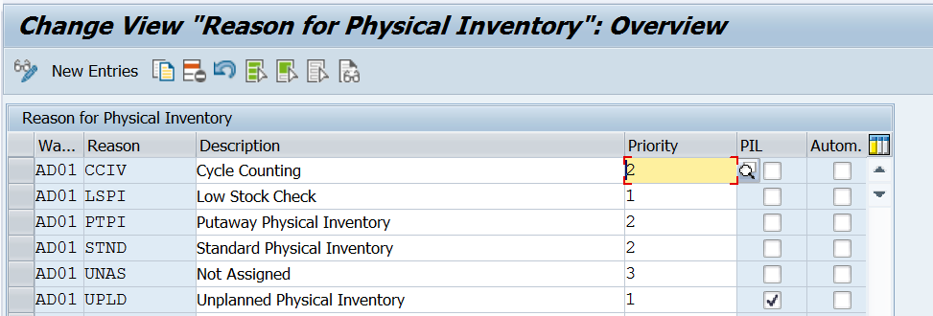
Define Reason for Physical Inventory
www.anubhavtrainings.com

Slide 14
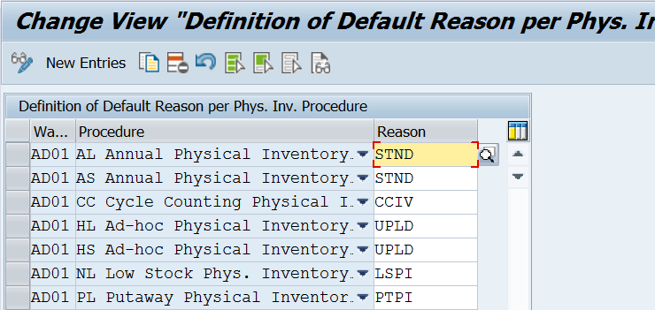
Define Standard reason for each PI procedure

Slide 15
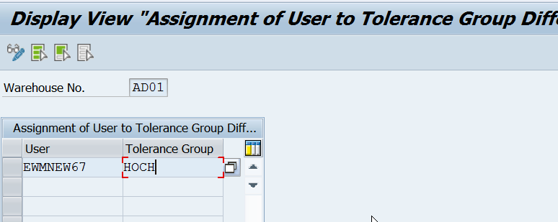
Maintain Master data
Assign user to Tolerance group for Difference Analyzer - /scwm/pi_user_diff
www.anubhavtrainings.com

Slide 16
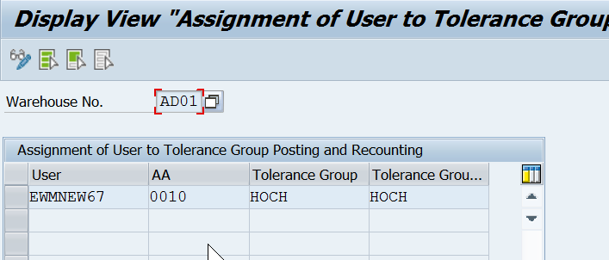
Assign user to Tolerance group for recount/clearing - /scwm/pi_user

Slide 17
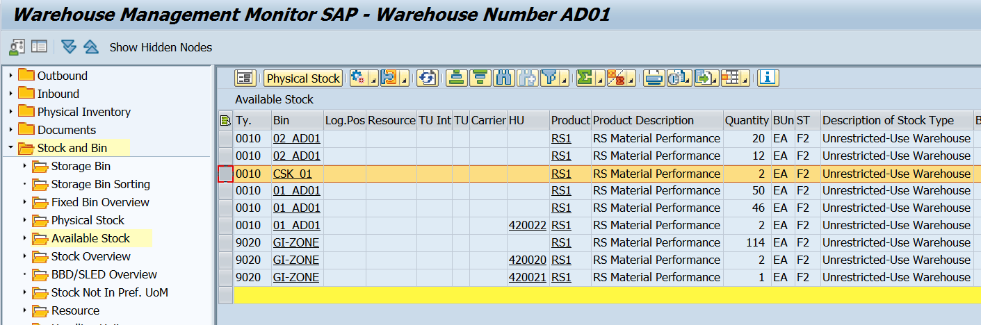
Test Scenario (Storage bin specific)
1.Observe the stock in Warehouse monitor

Slide 18
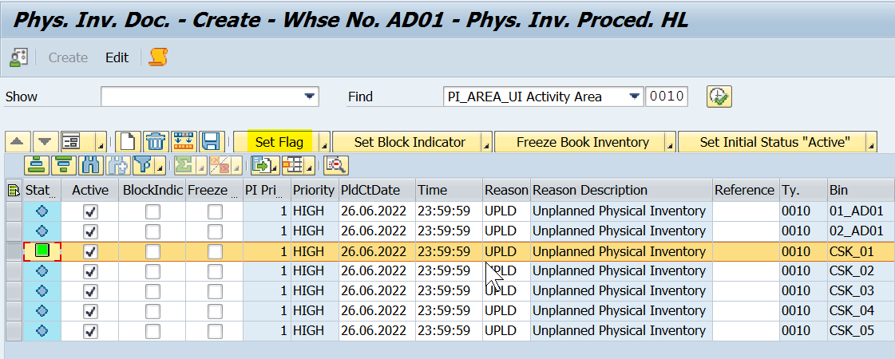
2.Create PI Document using /scwm/pi_create > select and set flag
PI Doc 5002 created.

Slide 19
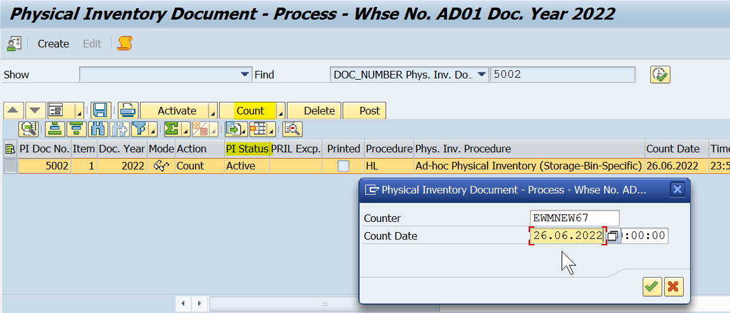
3. Assign Counter and enter Count

Slide 20
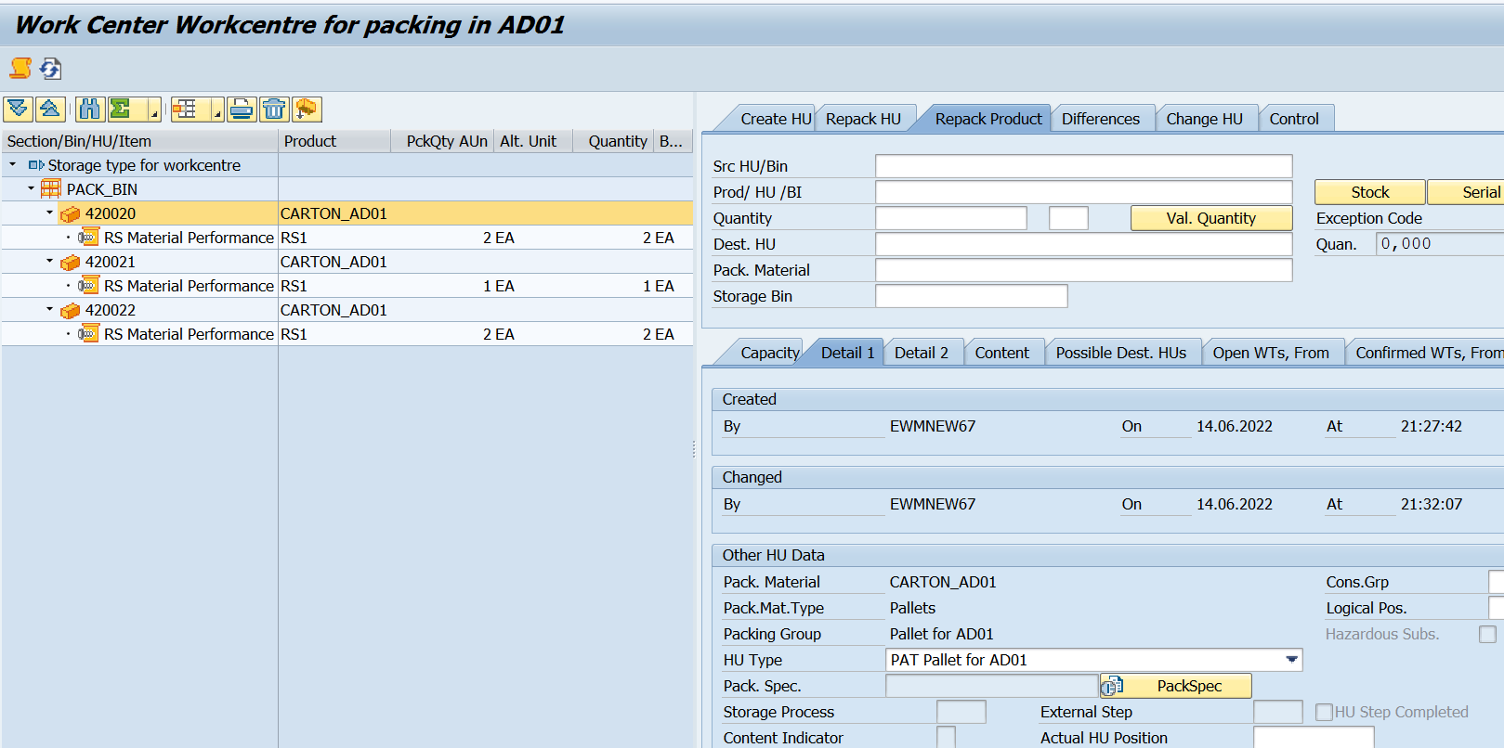
4. Enter Parent object, item cate., Counted qty, Product, ST, Owner, PED and Save (status will change to Counted)
www.anubhavtrainings.com

Slide 21
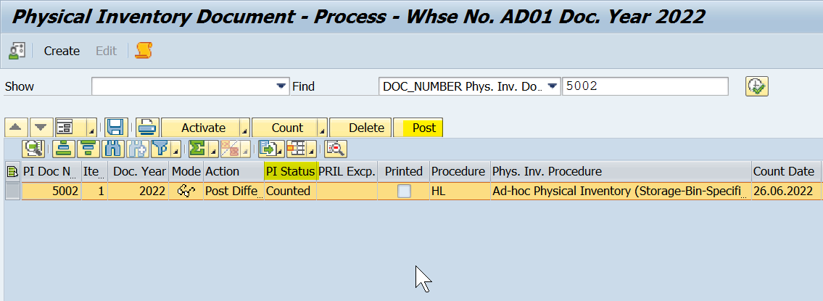
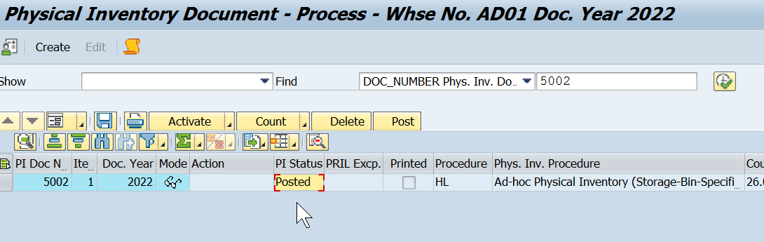
5. Post the difference (EWM)
www.anubhavtrainings.com

Slide 22
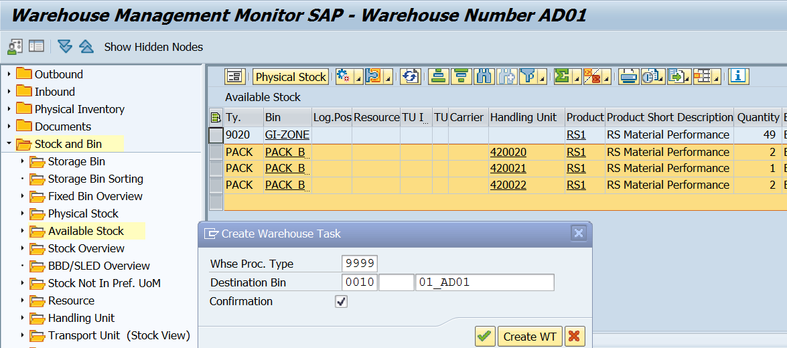
6. Difference posted in EWM side, Check the result in WH monitor

Slide 23
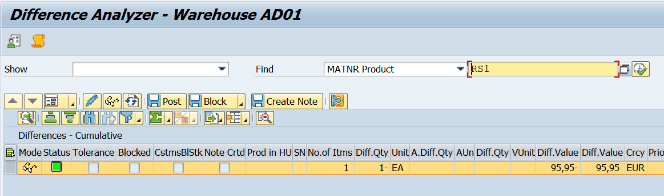
7. Post the difference for ERP Side (/scwm/diff_analyzer)
Note – WT created to update data in ERP side)

Slide 24
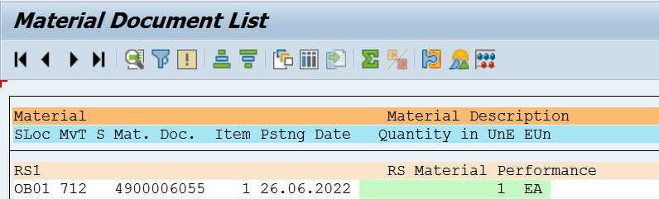
Observe the results in MMBE

Slide 25
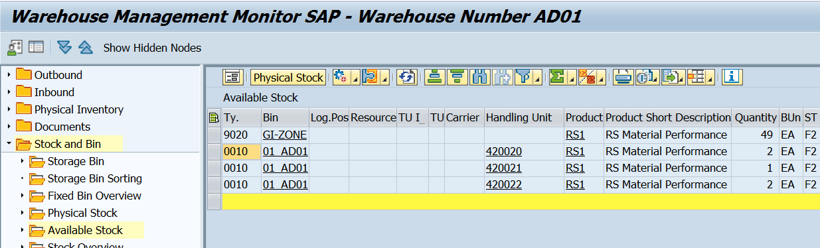

Slide 26


End of Session 10
www.anubhavtrainings.com

Slide 27

FEEL FREE TO ASK QUESTIONS

Slide 28

Feedback

Slide 29
THANK
YOU

Slide 30

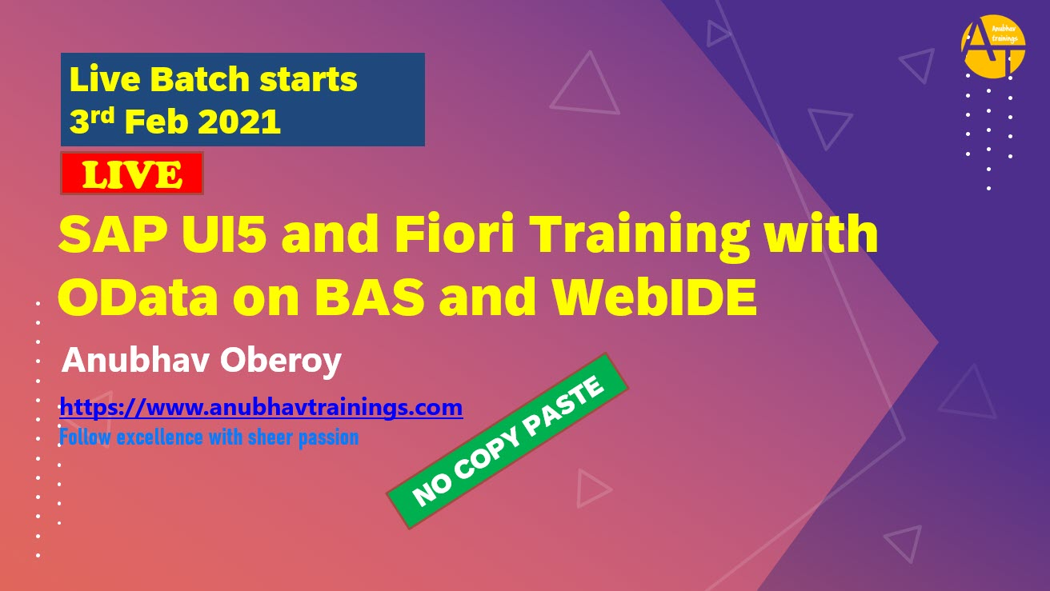

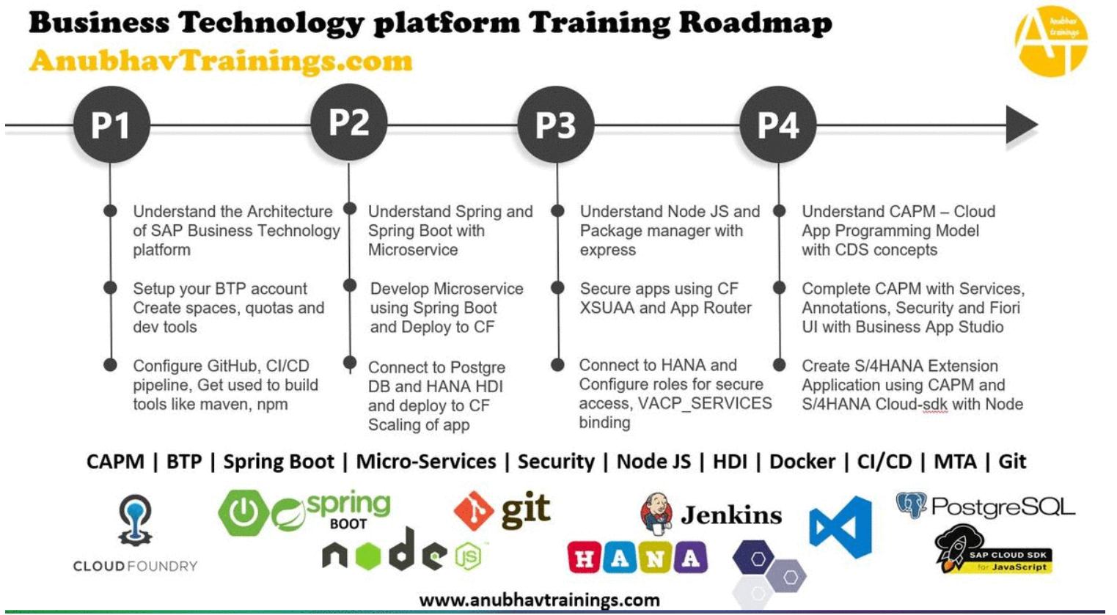
More from AnubhavTrainings.com

Slide 31






We’re committed to empower you to be
#FutureReady
through powerful training solutions.
We build the workforce of the future.
250+
Corporate Clients
30,000+
Learners Trained
25000+
Learners Placed
FREE WEBINARS
Sign up for free webinars with industry experts every fortnight!
Enroll Now!

Slide 32
FREE WEBINARS
Sign up for free webinars with industry experts every fortnight!
Contact us today!
www.anubhavtrainings.com

